Slide 1
Business Problem: Filling the Shelves
Day One ML – Module 1

Slide 2
Books in the Amazon Product Catalog
To sell books on Amazon.com we require certain information about the book itself (price, title, author, description, etc.).

Slide 3
Books in the Amazon Product Catalog
To sell books on Amazon.com we require certain information about the book itself (price, title, author, description, etc.).
Currently, Amazon.com product catalog contains approx. 6M unique book titles.

Slide 4
Books in the Amazon Product Catalog
To sell books on Amazon.com we require certain information about the book itself (price, title, author, description, etc.).
Currently, Amazon.com product catalog contains approx. 6M unique book titles.
The most important piece of information we need to have for any book is the price.
Notes:
Hazmat problem???

Slide 5
Crucial Gaps in the Catalog
What if due to data loss or buyer error…
the price information is missing?!

Slide 6
Crucial Gaps in the Catalog
What if due to data loss or buyer error…
the price information is missing?!
Even if just 1% of books in Amazon’s catalog were missing a price, that equals ~60,000 books that can’t be sold.

Slide 7
Crucial Gaps in the Catalog
What if due to data loss or buyer error…
the price information is missing?!
Even if just 1% of books in Amazon’s catalog were missing a price, that equals ~60,000 books that can’t be sold.
We cannot manually add prices as the product catalog constantly updates and grows → require an automated solution.
Notes:
(missing description or dimension is not great, but not a blocker).

Slide 8
Let’s try out some ideas
Let’s try simple ‘if – then’ rule (short books should be cheaper, as there is less material cost).
If book > 200 pages: 30 USD, else: 10 USD.

Slide 9
Let’s try out some ideas
Let’s try simple ‘if – then’ rule (short books should be cheaper, as there is less material cost).
If book > 200 pages: 30 USD, else: 10 USD.
What could go wrong?

Slide 10
Let’s try out some ideas
Let’s try simple ‘if – then’ rule (short books should be cheaper, as there is less material cost).
If book > 200 pages: 30 USD, else: 10 USD.
A 1000+ page book for just $30?! …cheating with font size? Hardcover?
What could go wrong?

Slide 11
Let’s try out some ideas
Let’s try simple ‘if – then’ rule (short books should be cheaper, as there is less material cost).
If book > 200 pages: 30 USD, else: 10 USD.
A 1000+ page book for just $30?! …cheating with font size? Hardcover?
Need a smarter & scalable way to fill gaps → Machine Learning!
What could go wrong?

Slide 12
What is ML?
Day One ML – Module 1

Slide 13


Trainer Intro
Instructor: Bipeen Sinha
Microsoft Certified Trainer
Amazon Authorized Instructor
Microsoft Trainer Academy
25+ years of successful experience in full life cycle of Training and Planning, Designing, Deployment and Management of IT services and products include Microsoft Core Technology.
BIPEEN SINHA

Slide 14
Traditional: Rules-based
Data
Rules get applied to Data (classical programming)
Answers
Rules
Notes:
So, what is Machine Learning?
Arthur Samuel, an American computer scientist, IBMer and pioneer of the field of Artificial Intelligence, coined the term in 1959 by stating that
“Programming computers to learn from experience should eventually eliminate the need for much of this detailed programming effort”
“A computer can be programmed so that it will learn to play a better game of checkers than can be played by the person who wrote the program.”
In other words, ML is teaching a machine to learn how to do a task,
through algorithms that can learn from experience
without relying on rules-based programming.
That sounds very similar to classical programming, still need to code something...
the key difference is that in classical programming, you need to provide an exact recipe (code, sequence of steps/if/else/etc)
that tells the machine what rules to apply to solve the problem and provide the answers.
Now, manually crafting and enhancing rules can be a difficult and cumbersome task,
sometimes impossible as we don’t know the rules to begin with,
And often requires that golden/rare piece of domain expertise/top expert perspective you saw in the Data Science diagram
Think of writing a program for the complex task of face recognition

Slide 15
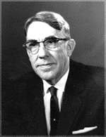
What is Machine Learning?
Data
Rules get applied to Data (classical programming)
Answers
Rules
“Programming computers to learn from experience should eventually eliminate the need for […] detailed programming effort.”
Arthur Samuel, 1959 Pioneer of AI research
Data
ML Model (learns rules from data using algo)
Answers
ML Algorithm
New Data
Notes:
WITH ML: we move this heavy lifting onto the machine
Still need to provide some code (ML algorithm, a set of instructions) and DATA (ideally with answers)
but that code will instruct the machine how to learn/extract the RULES from the DATA&ANSWERS
These Machine-Inferred / Machine-Learned RULES, which are what’s called,
the trained ML model
can then be further used to provide answers to new similar problems, on new similar data.

Slide 16
Types of Machine Learning
Day One ML – Module 1

Slide 17
Supervised vs. Unsupervised Learning
Data is provided with labels
Model learns by looking at these examples
Supervised Learning
Unsupervised Learning
Data is provided without labels
Model finds patterns in data
Notes:
Aside from labeled or unlabeled data,
another interesting thing about Machine Learning is the
variety of Machine Learning algorithms, sometimes to solve the same type of problem.
While certain algorithms tend to perform better than others with certain types of data,
no single algorithm outperforms all others on all problems.
This concept is called the no free lunch theorem.
And so, for a given task/problem,
choose a few algorithms known to work well for that type of data and problem,
and select the best-performing one.
Let’s narrow down initial choices by dividing ML algorithms into categories,
based on the task they perform and how they perform it.

Slide 18
Supervised vs. Unsupervised Learning
Supervised Learning
Unsupervised Learning
ML Problems
Regression (Quantity)
Classification (Category)
Clustering
Notes:
While there are some gray boundaries when it comes to problem types and learning types,
Classification and Regression are part of supervised learning, (predict book prices, predict books genre)
while
Clustering is a form of unsupervised learning (identify fraudulent listings)
[CLICK for Next Slide]

Slide 19
Supervised vs. Unsupervised Learning
Supervised Learning
Unsupervised Learning
ML Problems
Regression (Quantity)
Classification (Category)
Clustering
Business Problems
e.g., book price prediction
e.g., book genre prediction
e.g., fraudulent book listings
Notes:
While there are some gray boundaries when it comes to problem types and learning types,
Classification and Regression are part of supervised learning, (predict book prices, predict books genre)
while
Clustering is a form of unsupervised learning (identify fraudulent listings)
[CLICK for Next Slide]

Slide 20
Supervised vs. Unsupervised Learning
Supervised Learning
Unsupervised Learning
Regression (Quantity)
Classification (Category)
Clustering
ML Algorithms
Linear Regression
K-Nearest Neighbors
Neural Nets
Decision Trees
…
Support Vector Machine
K-Nearest Neighbors
Neural Nets
Decision Trees
…
PCA
Collaborative Filtering
K-Means
…
Notes:
Aside from labeled or unlabeled data,
another interesting thing about Machine Learning is the
variety of Machine Learning algorithms, sometimes to solve the same type of problem.
While certain algorithms tend to perform better than others with certain types of data,
no single algorithm outperforms all others on all problems.
This concept is called the no free lunch theorem.
And so, for a given task/problem,
choose a few algorithms known to work well for that type of data and problem,
and select the best-performing one.
Let’s narrow down initial choices by dividing ML algorithms into categories,
based on the task they perform and how they perform it.
[READ Descriptive Text]
[CLICK for Next Slide]

Slide 21
Supervised Machine Learning
Day One ML – Module 1

Slide 22
Supervised Learning: Regression
Supervised Learning
Price [$]
Regression (Quantity)
Classification (Category)
# Pages
Label
Features
Linear Regression
K-Nearest Neighbors
Neural Nets
Decision Trees
…
Support Vector Machine
K-Nearest Neighbors
Neural Nets
Decision Trees
…
Price [$] | # Pages | Days pub. | Language | # Reviews
28 | 320 | 100 | EN | 2000
21 | 210 | 500 | DE | 400
… | … | … | … | …
Notes:
Let's talk about regression first - a very popular Supervised Learning problem type
Regression aims to learn relationships and correlations between input features and a continuous output variable,
with the scope of predicting the continuous output variable.
For example, the price of a house might depend on a certain combination of no of bedrooms, sqfootage, age and so on.
Shown here, for simplicity, a simple linear regression model,
assuming the relationship between the sale price of a house and the sqFootage is linear,
that is a straight line.
- as sqf increases, the price of the house increases.
Given historical data, that is sale prices of houses with these characteristics on the market,
one can learn such linear model that can be later used to predict the sale price of a new given home based on its descriptors / the sqfootage here.
Some ML algorithms that can be used to build regression models, are listed below:
Linear regression, KNN, Decision Trees, NN

Slide 23
Supervised Learning: Classification
Predict 0
Predict 1
Supervised Learning
/1 = Fiction
/0 = Non-Fiction
Days published
Regression (Quantity)
Classification (Category)
# Pages
Label
Features
Linear Regression
K-Nearest Neighbors
Neural Nets
Decision Trees
…
Support Vector Machine
K-Nearest Neighbors
Neural Nets
Decision Trees
…
Fiction | # Pages | Days pub. | Language | # Reviews
1 | 320 | 100 | EN | 2000
0 | 210 | 500 | DE | 400
… | … | … | … | …
Notes:
If you’d rather be interested to know whether the house given its characteristics will sell fast or not, that would be what’s called classification.
The other very popular Supervised Learning problem type, classification,
aims to learn relationships between input features and a output variable,
with the scope of separating the data into classes/groups.
The main difference between REGR and CLASS is that the output variable in regression is numerical (or continuous) while that for classification is categorical (or discrete).
For example, the star or not star classes shown here correspond to a certain combination of no of points, edges and size here…
This is what we call, a binary classification scenario, that is we only have two classes.
Some ML algorithms that can be used to build classification models, are …
Logistic Regression, SVM, KNN, Decision Trees, NN

Slide 24
Unsupervised Machine Learning

Slide 25
Unsupervised Learning: Clustering
Unsupervised Learning
# Reviews
Days pub.
Clustering
Features
# Pages | Days pub. | Language | # Reviews
320 | 100 | EN | 2000
210 | 500 | DE | 400
… | … | … | …
K-Means
PCA
Collaborative Filtering
…
Notes:
One example of Unsupervised Learning is clustering,
That involves grouping unlabeled data points according to their features.
For example, clustering can be used in market segmentation;
where we try to find customers that are similar to each other
whether in terms of behaviors or attributes.
Feature 1 could be age, and feature 2 could be the type of music the customers are listening to
Given that a visual overview of the data sometimes doesn’t suggest an obvious choice for the number of clusters, (or when it’s hard to visualize data to begin with – for example if we would like to use more than 4 features say)
If we don’t see or have prior information of how many clusters might be there
or a request from the business to produce a specified number of clusters,
the next challenge is to determine how many clusters to extract. This is a bit of a judgment call.
There are some metrics we can use to guide decision-making here,
but it’s most important that the clusters make sense and meet our objective
i.e., identifying as distinct as possible customers clusters for the business.

Slide 26
Unsupervised Learning: Clustering
Unsupervised Learning
# Reviews
Days pub.
Clustering
Features
# Pages | Days pub. | Language | # Reviews
320 | 100 | EN | 2000
210 | 500 | DE | 400
… | … | … | …
K-Means
PCA
Collaborative Filtering
…
Notes:
The most common kind of clustering is therefore called K-means clustering,
which involves first selecting K the number of desired clusters
and then partitioning the data into these K clusters
such that data points in each cluster are as similar as possible.
One possible outcome for our market segmentation problem is shown here for K = 3.
[During model training, the K-means algorithm uses the distances from datapoints to 3 possible centroids to assign the datapoints to the closest cluster centroid.]

Slide 27
ML Lingo Summary
Label = output you are trying to predict
Feature = data input to help you make predictions
Supervised learning
Trying to predict a specific label (quantity) using features
Need training data with labels
Can measure model performance directly
Unsupervised learning
Looking for structure or unusual patterns (“understand” the data)
No labeled data
Evaluation usually indirect (since not predicting something specific)
Notes:
This is recap of the previous module and gateway to – ‘practical considerations for ML’.

Slide 28
Module 2:
Identifying ML Opportunities

Slide 29
Using ML in practice
Not all problems are suitable for machine learning. How do you know if ML is right for your problem?
Let’s define some questions that guide us through the ML Lifecycle: Machine Learning Decision Questions.

Slide 30

MLDQ Handbook
We summarized some of the most important questions in a handbook:
You can find the Machine-Learning-Decision-Questions.pdf on the MLU Day One Course Content website.
Machine-Learning-Decision-Questions.pdf

Slide 31

Business problem
Problem formulation
Data processing
Model training
Evaluation
Deployment
When to use ML:
Specific & measurable
Scalability
Adaptability & Responsiveness
Complexity
Notes:
When you encounter a problem, it is important to start by evaluating if it is or is not a good fit to be solved with machine learning. To aid in this, let’s examine 4 points which are indicative of being a good fit for using machine learning, and then on the next slide we’ll talk through some points which are not a good fit. A problem you encounter will not need to satisfy all of these, but if it satisfies none of them you should really consider if the problem is best solved with ML.
First, the problem should require complex logic. If the task can be solved easily with a few hand-coded rules, or simple heuristics work well enough for the business case, don’t take on the additional complexity of machine learning! It will likely not be worth the investment. This point can be subtle, as there are many problems which may be complex, like some supply chain optimization problems, which are already optimally solved by existing efficient and scalable algorithms.
Second, if scalability is a challenge, that is a strong indicator that ML could help. If there is a task that you normally require a human to do, but you want to do it millions of billions of times, training an ML model to perform that task, and then deploying it at scale is a good solution.
Third, if we need to make predictions for unseen data, we need ML. Especially if need the system to be more responsive than a human could achieve. If there is a task that would normally require human reasoning that you need done in less than a tenth of a second, ML is often an excellent solution. Examples include things like face detection for autofocus on cameras, or automated content moderation on a social media platform.
Finally, this applies to all – the problem needs to be specific and measurable with a real business goal in mind.

Slide 32
Business problem
Problem formulation
Data processing
Model training
Evaluation
Deployment
When to NOT use ML:
Traditional algorithms
Requires 100% accuracy
Requires full interpretability
Notes:
Conversely, let’s now talk about some factors of problems that mean that ML cannot be successfully applied. Having one of these does not mean that ML cannot be used, but it might inform choices that need to be made during the development process, or lead to an extended timeline for development.
[CLICK]
First is just a reiteration of what we’ve said before: if the problem can be solved with existing efficient algorithms, ML will provide no benefit.
[CLICK]
If the problem requires 100% accuracy, you should not use ML. Machine learning is inherently about estimation, and can provide no guarantees of perfect accuracy.
[CLICK]
Finally, if interpretability is required then that limits the types of ML that can be applied to a problem. Unlike a human, we cannot ask the algorithm how it made its decision. The majority of the most powerful ML models are black-box models, producing results with no indication of why.

Slide 33
Example MLDQs
What makes this problem suitable for Machine Learning?
What business goal can be achieved by building a ML solution to tackle this problem?
What kind of ML model (regression/classification/clustering?) can solve this problem?
What data might be necessary to address this problem? Is the data already available & relevant?
How accurate/good does the model need to be?*

Slide 34
Let’s apply MLDQs to Amazon Use Cases
Day One ML – Activity 1
Notes:
Here we’re going to give you the chance to share your business problem you wrote down at the beginning of class so you can get feedback on how to turn it into an ML problem.

Slide 35
Use Case 1: Backfilling Missing Attributes
We will now use a subset of questions from the MLDQ handbook to discuss ML problems that teams at Amazon have faced.
For many products in the Amazon Catalog, attributes (e.g. color, size) are missing or incorrect. Amazon loses customer trust when product results don’t match what a customer is looking for, and loses sales when ASINs (product attributes) have been labeled incorrectly or are undiscoverable.
We want to build ML models that can predict attributes from product images; for example color. We can use those models to predict and backfill the color attribute in the catalog.

Slide 36

Molino
https://w.amazon.com/bin/view/InTech/Tamale/Projects/Molino/
Notes:
Molino deploys several types of ML models to predict different attributes (color, style).

Slide 37
MLDQs for discussion
What makes this problem suitable for Machine Learning?
Manual extraction and labelling of colors is not scalable. Simple rules based on pixel inspection will not solve many real cases (presence of a human model, pictures with large white background areas, etc.)

Slide 38
MLDQs for discussion
What makes this problem suitable for Machine Learning?
Manual extraction and labelling of colors is not scalable. Simple rules based on pixel inspection will not solve many real cases (presence of a human model, pictures with large white background areas, etc.)
What business goal can be achieved by building a ML solution to tackle this problem?
Customer trust: Complete and accurate product information across all marketplaces will provide a better shopping experience to Amazon customers and will lead to higher customer trust, increasing sales.

Slide 39
MLDQs for discussion
What makes this problem suitable for Machine Learning?
Manual extraction and labelling of colors is not scalable. Simple rules based on pixel inspection will not solve many real cases (presence of a human model, pictures with large white background areas, etc.)
What business goal can be achieved by building a ML solution to tackle this problem?
Customer trust: Complete and accurate product information across all marketplaces will provide a better shopping experience to Amazon customers and will lead to higher customer trust, increasing sales.
What kind of ML model (regression/classification/clustering?) can solve this problem?
Multi-class classification (many different colors) can be used.

Slide 40
MLDQs for discussion
What data might be necessary to address this problem? Is the data already available & relevant?
To solve this, we need a dataset with images with correspondent color labels. Potentially, some sellers may already provide color values for their products but those may be not accurate and require additional verification.

Slide 41
MLDQs for discussion
What data might be necessary to address this problem? Is the data already available & relevant?
To solve this, we need a dataset with images with correspondent color labels. Potentially, some sellers may already provide color values for their products but those may be not accurate and require additional verification.
How accurate/good does the model need to be?
Various classification metrics may be used, including accuracy, precision and recall. However, to keep the quality bar high we define thresholds for every class so only very confident predictions are published to the catalogue (i.e. with precision > 90%).

Slide 42
Let’s apply this to YOUR Problem ☺
Day One ML – Activity 2
Notes:
Here we’re going to give you the chance to share your business problem you wrote down at the beginning of class so you can get feedback on how to turn it into an ML problem.

Slide 43
Applying MLDQs to YOUR problem
We will now use the same subset of questions from the MLDQ handbook as in the last activity to discuss the ML problems we asked you to write down at the beginning of the class in small breakout groups.
If you don’t have a suitable ML problem, we will share an example for discussion.

Slide 44
Break into groups
In your self-assigned groups, use the provided Chime ID to join the call. Once on the call, present the ML problems we asked you to write down at beginning of class (copy & paste or present verbally).
As group, select one ML problem and use the MLDQs on the next slide to guide your discussion.
Re-join this call after 15 minutes to share your experience.

Slide 45
MLDQs for discussion
What makes this problem suitable for Machine Learning?
What business goal can be achieved by building a ML solution to tackle this problem?
What kind of ML model (regression/classification/clustering?) can solve this problem?
What data might be necessary to address this problem? Is the data already available & relevant?
How accurate/good does the model need to be?

Slide 46
Get your instance ready please!

Slide 47
Module 3:
ML Lifecycle & Building Models with AutoGluon

Slide 48
Machine Learning Lifecycle

Slide 49
Machine Learning Lifecycle
Answer
New Data/Re-training
Deployment
Business Problem
Yes
Data Processing
Data Collection
Data Exploration
Data Cleaning
…
Model
Training
Tuning
Testing
Evaluation
ML Problem Formulation
No
Notes:
With access to DATA, COMPUTE and ALGORITHMS,
How to do ML? what are the steps to follow?
Putting it all together here as ML Lifecycle, a preview of how much work is ahead…
As mentioned, all starts identifying a Business Problem and formulate the ML Problem
This is a step not to be taken lightly – will impact most of the downstream task
Ask pointed questions:
What are the business outcomes you are trying to achieve?
What does success look like for you?
What business metric to define?
Once settled on the ML Problem, the next step is also time consuming: Data
Know your problem/know your data! (again, and again, the domain expertise of the DS diagram!)
Get all relevant data in one place, cleaned and processed, in a so-called ML-friendly format
That will be all numericals, so you’ll have do to some data processing on those non-numerical features
Maybe also weed out some non-relevant features, or add some relevant ones in, etc
With your ML-friendly data and the right choice of ML algorithm, then
train-tune-validate an ML model
that can be deployed and used in production to produce the desired outcomes, if meets the business goals,
or can be tweaked further until meets the bar, otherwise.

Slide 50
Business problem
Problem formulation
Problem formulation
Data processing
Model
Evaluation
Deployment
Define the business objective:
Specific, measurable milestones that helps increase revenue, decrease cost, etc.
Translate objective to an ML problem:
Express the objective in machine learning terms, e.g., predicting, calculating the probability, etc.
Increase revenue by ensuring all products in catalog have prices & can be surfaced to customer.
Predict price (continuous numerical value) for all products in catalog where price is missing.

Slide 51
Business problem
Problem formulation
Data processing
Model
Evaluation
Deployment
Merging files from different sources together
Clean up data (dealing with missing values, skews…)

Slide 52
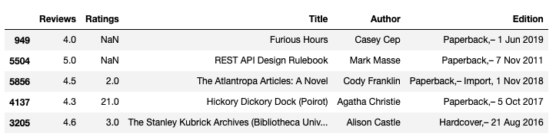
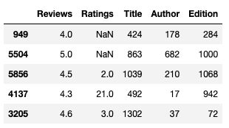
Business problem
Problem formulation
Data processing
Model
Evaluation
Deployment
Merging files from different sources together
Clean up data (dealing with missing values, skews…)
Convert all values to numbers (computers don’t understand text):
Tab 2 & 3: Example of conversion from original dataset to only numerical values with AutoGluon.

Slide 53
Business problem
Problem formulation
Data processing
Model
Evaluation
Deployment
Merging files from different sources together
Clean up data (dealing with missing values, skews…)
Convert all values to numbers (computers don’t understand text):
Splitting dataset into train/test/validation sets
Original dataset
Training set
(used to train the model)
Split
Validation set
(used for unbiased evaluation of the model)
Test set
(used for final evaluation of the model)

Slide 54
Business problem
Problem formulation
Data processing
Model training
Evaluation
Deployment
Supervised models:
Train (learn) by comparing the error between prediction and true values (labels).
Unsupervised models:
Train (learn) by comparing the results of grouping similar things together. Similarity can be defined in different ways, e.g. distance, intersections of features.
Notes:
Aside from labeled or unlabeled data,
another interesting thing about Machine Learning is the
variety of Machine Learning algorithms, sometimes to solve the same type of problem.
While certain algorithms tend to perform better than others with certain types of data,
no single algorithm outperforms all others on all problems.
This concept is called the no free lunch theorem.
And so, for a given task/problem,
choose a few algorithms known to work well for that type of data and problem,
and select the best-performing one.
Let’s narrow down initial choices by dividing ML algorithms into categories,
based on the task they perform and how they perform it.
Animation for training: https://towardsdatascience.com/gradient-descent-animation-1-simple-linear-regression-e49315b24672

Slide 55
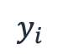
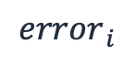
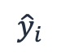
Business problem
Problem formulation
Data processing
Model
Evaluation
Deployment
Evaluation: Regression
Find distance (squared, absolute, …) between your prediction and labels.
Price [$]
$$y_{i}$$
True values
$${error}_{ i}$$
Predicted values
$${\hat{y}}_{i}$$
# Pages
Notes:
Evaluating REGR models: Let’s first note that all these four regr metrics are looking at the overall model errors, either taking these errors in abs values or squared values (so that the negative errors can contribute in a meaningful way to the overall sum)
What do we mean by errors, are the differences between the y_is = target values (these are the y of our black dots data points here) and y_hats = the values predicted with the regression model (that will be the y’s of the points sitting on the orange regression line)
The first metric, the MSE (short for Mean Sq Error) is the average of the squared errors
As MSE squares the error differences, it penalizes even the smallest errors, leading to over-estimation of how bad the model is.
The next metric, the RMSE short for Root Mean Sq Error is also widely used for regression tasks, simply being the square root of the Mean Sq Error.
While Mean Sq Error reports errors in units squared, the Root Mean Sq Error reports the errors in the original units, making it easier to interpreted the error.
MAE short for…: is the average of the absolute differences between the target values and the values predicted by the model.
Being a linear score, all the individual differences are weighted equally, hence the MAE is more robust to outliers and does not penalize the errors as extremely as MSE.
R² on the other hand is a metric that helps compare our regr model with a constant average baseline model (that is predict averages for all data points), and tells us how much better the regr is vs this baseline model.
While with the other metrics, is desirable to lower the scores, the R2 is different.
Assuming that the ML model will always perform better than the baseline/average model, R² will take values between 0 and 1.
-If the regr model did not improve at all over the baseline model, producing same errors, R2 = 0 (lowest)
-The best regr model, meaning no errors between the predicted values and the actual values (MSE =0), R2 will be 1 (highest)
While the MSE is the most preferred metrics for regression tasks,
just like anything else with ML, there is no clear choice which metric to use.
Best practice is to monitoring a few, depending on the business problem and the dataset.
~~~~~~~~~~~~
LATEX
MSE = \frac{1}{n}\sum_{i=0}^{n}(y^{(i)}-\hat{y}^{(i)})^2
RMS = \sqrt{\frac{1}{n}\sum_{i=0}^{n}(y^{(i)}-\hat{y}^{(i)})^2}
MAE = \frac{1}{n}\sum_{i=0}^{n}|y^{(i)}-\hat{y}^{(i)}|
R^2 = 1 - \frac{\sum_{i=0}^{n}(y^{(i)}-\hat{y}^{(i)})^2}{\sum_{i=0}^{n}(y^{(i)}-\bar{y})^2}
\bar{y} = \frac{1}{n}\sum_{i=0}^{n}y^{(i)}
y^{(i)} \hat{y}^{(i)} \bar{y}

Slide 56
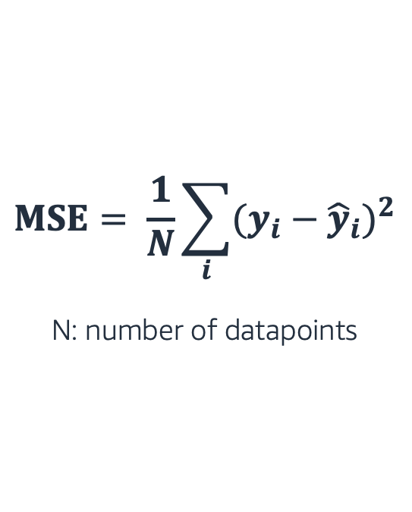
Business problem
Problem formulation
Data processing
Model
Evaluation
Deployment
Evaluation: Regression
Find distance (squared, absolute, …) between your prediction and labels.
Aggregate up into 1 value across whole dataset (e.g. mean error across squared distances, MSE).
$$MSE= \frac{1}{N}\sum_{i}{{(y_{i}−{\hat{y}}_{i})}^{2}}$$
N: number of datapoints
Notes:
Evaluating REGR models: Let’s first note that all these four regr metrics are looking at the overall model errors, either taking these errors in abs values or squared values (so that the negative errors can contribute in a meaningful way to the overall sum)
What do we mean by errors, are the differences between the y_is = target values (these are the y of our black dots data points here) and y_hats = the values predicted with the regression model (that will be the y’s of the points sitting on the orange regression line)
The first metric, the MSE (short for Mean Sq Error) is the average of the squared errors
As MSE squares the error differences, it penalizes even the smallest errors, leading to over-estimation of how bad the model is.
The next metric, the RMSE short for Root Mean Sq Error is also widely used for regression tasks, simply being the square root of the Mean Sq Error.
While Mean Sq Error reports errors in units squared, the Root Mean Sq Error reports the errors in the original units, making it easier to interpreted the error.
MAE short for…: is the average of the absolute differences between the target values and the values predicted by the model.
Being a linear score, all the individual differences are weighted equally, hence the MAE is more robust to outliers and does not penalize the errors as extremely as MSE.
R² on the other hand is a metric that helps compare our regr model with a constant average baseline model (that is predict averages for all data points), and tells us how much better the regr is vs this baseline model.
While with the other metrics, is desirable to lower the scores, the R2 is different.
Assuming that the ML model will always perform better than the baseline/average model, R² will take values between 0 and 1.
-If the regr model did not improve at all over the baseline model, producing same errors, R2 = 0 (lowest)
-The best regr model, meaning no errors between the predicted values and the actual values (MSE =0), R2 will be 1 (highest)
While the MSE is the most preferred metrics for regression tasks,
just like anything else with ML, there is no clear choice which metric to use.
Best practice is to monitoring a few, depending on the business problem and the dataset.
~~~~~~~~~~~~
LATEX
MSE = \frac{1}{n}\sum_{i=0}^{n}(y^{(i)}-\hat{y}^{(i)})^2
RMS = \sqrt{\frac{1}{n}\sum_{i=0}^{n}(y^{(i)}-\hat{y}^{(i)})^2}
MAE = \frac{1}{n}\sum_{i=0}^{n}|y^{(i)}-\hat{y}^{(i)}|
R^2 = 1 - \frac{\sum_{i=0}^{n}(y^{(i)}-\hat{y}^{(i)})^2}{\sum_{i=0}^{n}(y^{(i)}-\bar{y})^2}
\bar{y} = \frac{1}{n}\sum_{i=0}^{n}y^{(i)}
y^{(i)} \hat{y}^{(i)} \bar{y}

Slide 57
Business problem
Problem formulation
Data processing
Model
Evaluation
Deployment
Prediction
Evaluation: Classification
Compare true state to predicted state.
1 (positive)
0 (negative)
True Positive
False Negative
Predict 0
Predict 1
1 (positive)
/1 = Fiction
/0 = Non-Fiction
15
1
True State
Days published
False Positive
True Negative
# Pages
0 (negative)
3
18
Notes:
How about evaluating classification models?
In the case of the classification models (a binary classification task shown here for simplicity)
the performance of the model and its associated errors can be judged by examining
correctly classified cases vs incorrectly classified cases.
Given our star/not star example, here called positive/negative classes,
we define as TP those data points that were pred P when the
…
We record our classifier results in a so called confusion matrix –
(reflecting the fact that the classifier is sometimes confused and makes mistakes)
For our binary classification problem the matrix has 2 rows and 2 columns.
Across the top are the predicted class labels and down the side are the actual class labels.
Each cell contains the number of predictions made by the classifier that fall into that cell.
The Conf Matrix makes it easier to observe the relations between the classifier outputs, and
Examining the CM usually gives a good idea whether or not the classifier we built is bad or good.
In our case here, we seem to have done at pretty good job at assigning most data points to their correct classes…
A perfect classifier would correctly predict all cases, so high numbers would stay on the main orange diagonal and nothing would fall off this diagonal into the False/error tiles
While the confusion matrix contains all information of the outcomes of a classifier,
is rarely used for reporting results because is difficult to compare and discuss.
Instead, some overall numerical scores extracted from the confusion matrix are commonly used.

Slide 58
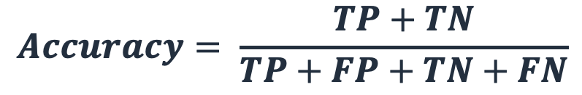
Business problem
Problem formulation
Data processing
Model
Evaluation
Deployment
Prediction
Evaluation: Classification
Compare true state to predicted state.
Aggregate up into 1 value across whole dataset by creating ratios (e.g. all correct predictions over total: accuracy).
1 (positive)
0 (negative)
True Positive
False Negative
1 (positive)
15
1
True State
False Positive
True Negative
$$Accuracy= \frac{TP+TN}{TP+FP+TN+FN}$$
0 (negative)
3
18
Notes:
How about evaluating classification models?
In the case of the classification models (a binary classification task shown here for simplicity)
the performance of the model and its associated errors can be judged by examining
correctly classified cases vs incorrectly classified cases.
Given our star/not star example, here called positive/negative classes,
we define as TP those data points that were pred P when the
…
We record our classifier results in a so called confusion matrix –
(reflecting the fact that the classifier is sometimes confused and makes mistakes)
For our binary classification problem the matrix has 2 rows and 2 columns.
Across the top are the predicted class labels and down the side are the actual class labels.
Each cell contains the number of predictions made by the classifier that fall into that cell.
The Conf Matrix makes it easier to observe the relations between the classifier outputs, and
Examining the CM usually gives a good idea whether or not the classifier we built is bad or good.
In our case here, we seem to have done at pretty good job at assigning most data points to their correct classes…
A perfect classifier would correctly predict all cases, so high numbers would stay on the main orange diagonal and nothing would fall off this diagonal into the False/error tiles
While the confusion matrix contains all information of the outcomes of a classifier,
is rarely used for reporting results because is difficult to compare and discuss.
Instead, some overall numerical scores extracted from the confusion matrix are commonly used.

Slide 59
Business problem
Problem formulation
Data processing
Model
Evaluation
Deployment
Training
/1 = Fiction
/0 = Non-Fiction
Original Dataset
Days published
/1 = Fiction
/0 = Non-Fiction
# Pages
Split
Validation
Days published
/1 = Fiction
/0 = Non-Fiction
# Pages
Days published
# Pages
Notes:
So let’s stick with the classification case and evaluate model performance on training and validation datasets.
Let’s first split some original dataset in two sets: training and validation…
[CLICK for Next Slide]

Slide 60
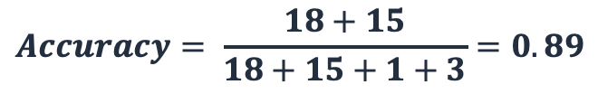
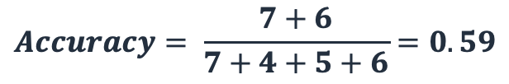
Business problem
Problem formulation
Data processing
Model
Evaluation
Deployment
Training
/1 = Fiction
/0 = Non-Fiction
Original Dataset
$$Accuracy= \frac{18+15}{18+15+1+3}=0.89$$
Days published
/1 = Fiction
/0 = Non-Fiction
# Pages
Split
Validation
Days published
/1 = Fiction
/0 = Non-Fiction
# Pages
$$Accuracy= \frac{7+6}{7+4+5+6}=0.59$$
Days published
# Pages
Notes:
So let’s stick with the classification case and evaluate model performance on training and validation datasets.
Let’s first split some original dataset in two sets: training and validation…
[CLICK for Next Slide]

Slide 61
Business problem
Problem formulation
Data processing
Model tuning
Evaluation
Deployment
Underfitting: Model is not good enough to capture the relation between the features and the output. Poor performance on train, validation and test.
Overfitting: Model memorizes and imitates training data, but fails to generalize well on new “unseen” data. Good performance on training, poor performance on validation/test data.
→ improve how model learns (hyperparameters) or give model different (new) data

Slide 62
Business problem
Problem formulation
Data processing
Model training
Evaluation
Deployment
What are hyperparameters?
Adjustable parameters in an algorithm that influence the training process: “options” or “settings” for the model training jobs.
ML models can have multiple hyperparameters.
Examples of hyperparameters?
Dropout (number of features to use)
Time (allocated time for training)
…

Slide 63
Business problem
Problem formulation
Data processing
Model tuning
Evaluation
Deployment
Learning
Original dataset
Training set
(used to train the model)
Train, tune, and validate the model (multiple times!)
Split
Validation set
(used for unbiased evaluation of the model)
Testing
Test set
(used for final evaluation of the model)
(Final) Test the model

Slide 64
Business problem
Problem formulation
Data processing
Model training
Evaluation
Deployment
Inference
Input
Model
Predictions
Cannot measure performance metric (beware of shifts)!
Deploy it to make predictions
Deployment
Once model performance is satisfactory, move to production
Yes
Evaluation
Notes:
Given new incoming x variables, and model f, predict y
Cannot measure accuracy since do not know true y in real-time
Predictions are then “consumed” by your business team/process and/or other downstream teams/processes
Input into business decisions, which may themselves be automated (or not)

Slide 65

Training $≠$ Reality
Covariate Shift: Distribution of training features is different than distribution in production features (temporal, spatial or less obvious reasons). E.g. “Web Search”:
Training with US vocabulary vs in production with UK vocabulary
Label Shift: Distribution of training labels is different than distribution in production labels (temporal, spatial or less obvious reasons). E.g. “Image Classifier”:
Balanced training examples vs non-uniform occurrence in reality
Notes:
Correction of label shift is harder to do because we don’t usually have the labels in test anymore. We can look compare confusion matrix of training set to confusion matrix of predictions. If the distributions are very different, we can work out what probability is for them to look so different.

Slide 66
ML Lifecycle in Practice

Slide 67
ML Lifecycle – Trial, Error & Iterations
fit()
predict()
Theory:
Practice:
Start with a simple model and once it’s working, try out more advanced models during many iterations.
What if we combine multiple models to find the best answer? → Ensemble Learning
What if we automatically prep data and train try all eligible models? → AutoML (AutoGluon)
Data
ML Model
Rules
Answers
ML Algorithm
New Data
Notes:
Aside from labeled or unlabeled data,
another interesting thing about Machine Learning is the
variety of Machine Learning algorithms, sometimes to solve the same type of problem.
While certain algorithms tend to perform better than others with certain types of data,
no single algorithm outperforms all others on all problems.
This concept is called the no free lunch theorem.
And so, for a given task/problem,
choose a few algorithms known to work well for that type of data and problem,
and select the best-performing one.
Let’s narrow down initial choices by dividing ML algorithms into categories,
based on the task they perform and how they perform it.

Slide 68
Ensemble Learning

Slide 69
Ensemble Learning
Ensemble methods create a model by combining the predictions of multiple models (base estimators, e.g. Decision Tree).
Each model is built with a given dataset and a given learning algorithm.
Ensemble Prediction
…
Model 1
Model 2
Model N
Data

Slide 70
Ensemble Learning Advantages
Advantages:
Many are better than few (ensemble prediction averages out the instability of individual models).
Models that learn differently can boost accuracy even if they are not great individually
Ensemble Prediction
…
Model 1
Model 2
Model N
Data

Slide 71
Ensemble Learning Disadvantages
Disadvantages:
Takes longer to train (each model learns separately)
More resources (computational power) required
More difficult to interpret
Ensemble Prediction
…
Model 1
Model 2
Model N
Data

Slide 72
AutoML & AutoGluon

Slide 73

What is AutoML?
Codification of the best Machine Learning practices for data prep, algorithm selection, model training (and model tuning).
Goal is to automatically:
Pre-process data (according to data type)
Split data into train, validation (& test)
Find best performing models & combinations of models
(Find best model parameters)

Slide 74
AutoGluon Design Principles
Simplicity: Users can train a model on the raw data directly without knowing the details about the data and ML models.
Robustness: Works with a variety of datasets and ensures training succeeds even when some of the individual ML models fail.
Predictive Timing: Returns the results within the time-budget specified by users
Notes:
AutoGluon anticipates and handles model training failures automatically.
AutoGluon also estimates future memory usage of individual models and skips expensive models & only loads one model into memory at a time.
→ AutoGluon fails on far fewer datasets compared to other AutoML solutions.

Slide 75
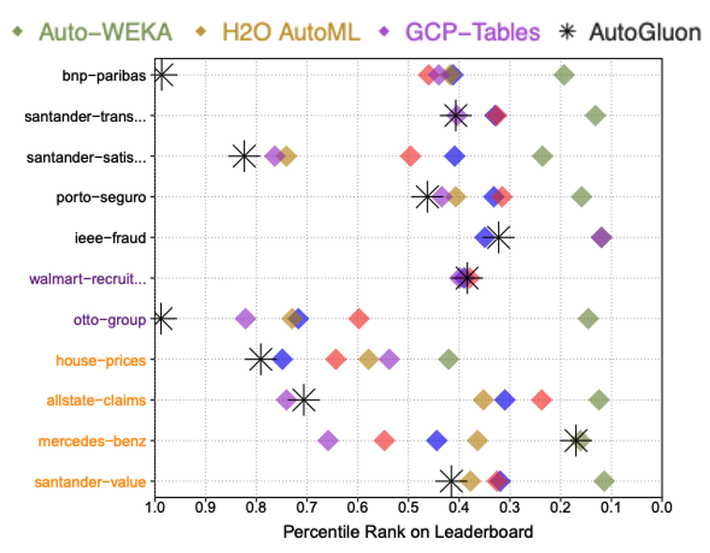
Can AutoGluon beat data scientists?
With just 24 hours of training time, AutoGluon managed to outperform 99.3% of data scientists participating in Kaggle competitions.
AutoGluon also achieves the highest raw accuracy among AutoML frameworks when directly predicting class labels.
https://arxiv.org/pdf/2003.06505.pdf

Slide 76
How can AutoGluon achieve these results?
AutoGluon:
Model ensembling via multi-layer stacking
Thoughtful data preprocessing & data prep
Greater emphasis on modern deep learning techniques
Less emphasis on hyperparameter optimization (optional)

Slide 77
K-fold Cross Validation (Example with K = 5)
Iteration-1
Iteration-2
Iteration-3
Iteration-4
Iteration-5
Training
Training
Training
Training
Validation
Training
Training
Training
Validation
Training
Training Set
Training
Validation
Training
Training
AutoGluon uses “repeated” k-fold cross validation if extra time remains. More trained models at the end.
Training
Training
Validation
Training
Training
Training
Validation
Training
Training
Training
Training
AutoGluon uses combined Out of the fold (validation) predictions for every data point in the training set as features for the next layer.
Notes:
We saw the training-validation sets earlier. Here, we introduce a new concept called “K-fold cross validation”. This gives you the opportunity to train and validate your choice of model multiple times, say K times, using the same dataset basically.
Here explained for K = 5
Repeat the following 5 times (Iterations 1-5):
Set aside 5th fold of the data for validation. This is also called “the hold-out set”.
Train the model on the remainder of the data: training set (4/5 of the original training set).
Test the model on the validation set (1/5 of the original training set).

Slide 78
Coding with AutoGluon

Slide 79
AutoGluon Installation
Install commands:
Brazil package:
https://code.amazon.com/packages/Python-autogluon/releases
python3 -m pip install -U pip
python3 -m pip install -U setuptools wheel
python3 -m pip install autogluon
Notes:
pip3 install -U pip pip3 install -U setuptools wheel pip3 install autogluon

Slide 80

3 lines of code!
Only 3 lines of code to train and use a model using tabular data (for e.g. book price prediction):
from autogluon.tabular import TabularPredictor
predictor = TabularPredictor(label="Price").fit("train.csv")
predictions = predictor.predict("test.csv")
Notes:
Label doesn’t just have to be classification.

Slide 81
3 lines of code!
Only 3 lines of code to train and use a model using tabular data in general:
from autogluon.tabular import TabularPredictor
predictor = TabularPredictor(label="label").fit("train.csv")
predictions = predictor.predict("test.csv")

Slide 82
3 lines of code!
Only 3 lines of code to train and use a model:
Specify the column that contains the label in the training dataset.
from autogluon.tabular import TabularPredictor
predictor = TabularPredictor(label="label").fit("train.csv")
predictions = predictor.predict("test.csv")
Fit on the training dataset (learn the rules).
Produce predictions of the "label" column for rows in separate test dataset “test.csv”

Slide 83
.fit() Method
fit()automatically does the following:
Preprocesses raw data (identifies the type of each feature and converts to numerical values)
Identifies what type of prediction problem this is (binary/multi-class classification or regression)
Splits data appropriately (e.g. disjoint training/validation sets, k-fold split)
Individually trains various base models, creates an optimized ensemble that outperforms all of the individual models

Slide 84
MLU-DAY-ONE-DEMO-UOMI.ipynb

Slide 85
Module 4:
Break & Hands-on Work

Slide 86
Time for Hands-On work!
Let’s apply what we’ve learnt to predict book prices for a real dataset: MLU-DAY-ONE-ML-Hands-On.ipynb
Follow the Hands-On Lab instructions to work on your code and make a submission to MLU Leaderboard.
The Chime call will stay open. For easier searchability please ask question through the class Slack channel.

Slide 87
MLU-DAY-ONE-ML-Hands-On.ipynb

Slide 88
Module 5:
Advanced Features & Solution Walkthrough

Slide 89
Advanced Features

Slide 90
Optional Settings
from autogluon.tabular import TabularPredictor
predictor = TabularPredictor(label="label").fit("train.csv",
time_limit=2*60, # train various models for approx. 2 minutes
num_bag_folds=5, # number for k-fold cross-validation
num_bag_sets=1, # how many times k-fold cross-vals repeated
num_stack_levels=1, # increase to stack more layers
hyperparameters={"NN_MXNET": {"num_epochs": XXX}, # hyperparam for NN
"GBM": {"num_boost_round": XXX}}) # hyperparam for GBM
predictions = predictor.predict("test.csv")
In practice: Replace the hyper parameter dummy values with actual numbers.
See the documentation here.
Notes:
https://auto.gluon.ai/stable/api/autogluon.predictor.html#autogluon.tabular.TabularPredictor
To make this work, you might need to install dependent libraries too.

Slide 91
Distillation
After Distillation
Original
AutoGluon’s ensemble can teach a simple model (student model) to perform better → gain inference speed with only small loss of model accuracy relative to teacher model.
Student model has low latency, low memory usage, high portability, and can still outperform much heavier ensembles created by other AutoML frameworks.
https://arxiv.org/pdf/2006.14284.pdf

Slide 92
Running Distillation in AutoGluon
To make these faster models, it again takes only one additional line of code:
student_models = predictor.distill(time_limit=XXX)
In practice: Replace the time limit dummy value with time in [s].
See the documentation here. Additional methods to speed up inference here.
Notes:
The time limit here is number of seconds
Distill AutoGluon’s most accurate ensemble-predictor into single models which are simpler/faster and require less memory/compute. Distillation can produce a model that is more accurate than the same model fit directly on the original training data. After calling distill(), there will be more models available in this Predictor, which can be evaluated using predictor.leaderboard(test_data) and deployed with: predictor.predict(test_data, model=MODEL_NAME). This will raise an exception if cache_data=False was previously set in fit().

Slide 93
Deployment
Deployment of models allows us to use them in production and connect to other systems within the company.
How to deploy AutoGluon models?
Create a Docker image in Sagemaker
Create your model
Deploy to an endpoint

Slide 94
AutoGluon Sub-Modules

Slide 95
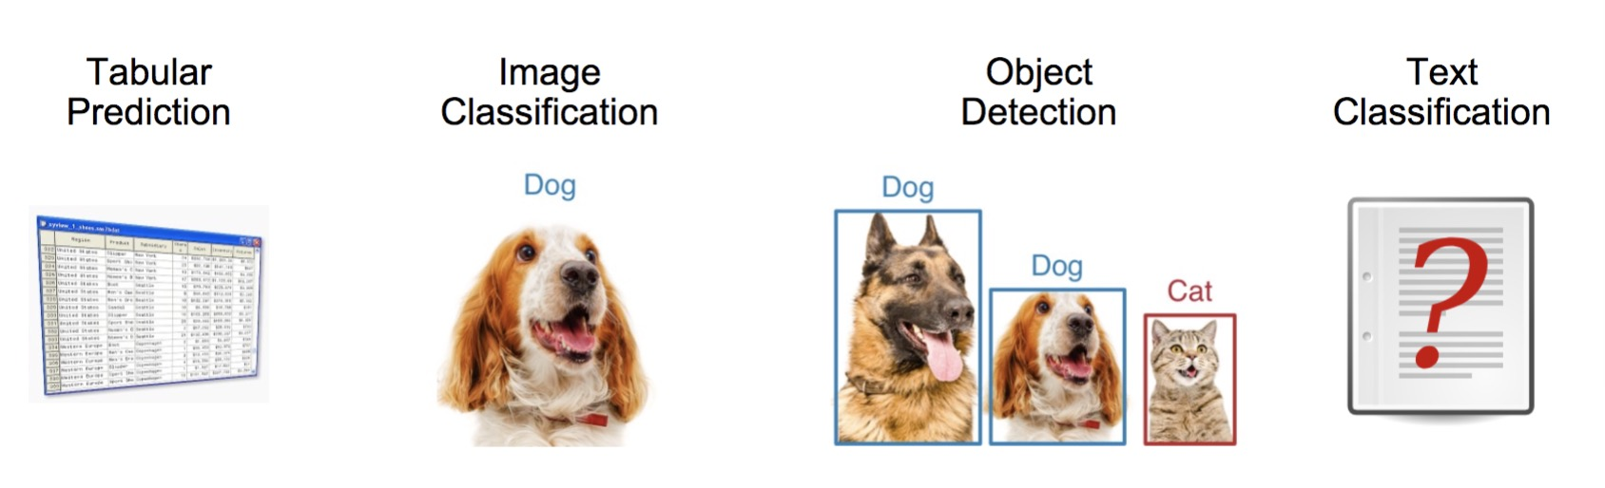
Sub-Modules for text and image tasks

Slide 96
Field | Machine Learning Task | Description
Computer Vision | Semantic Segmentation | Identify different scenes in images.
 | Image Classification | Provide categorical label for images.
 | Object Detection | Identifying object(s) in images.
Natural Language Processing | Sentiment Analysis | Classify text sentiment (e.g. positive, negative).
 | Text Classification | Assign document(s) to categories.
 | Question Answering | Automatically answer questions in natural language.
 | Machine Translation | Translate between languages.
RS | Recommender System | Predict ratings or preferences.

Slide 97
Image Prediction
import autogluon.core as ag
from autogluon.vision import ImagePredictor
# Load dataset
train_dataset, _, test_dataset = ImagePredictor.Dataset.from_folders(path_to_folder)
# Use AutoGluon to Fit Models
predictor = ImagePredictor()
predictor.fit(train_dataset)
# Predict on a New Image
image_path = test_dataset.iloc[0]['image']
prediction = predictor.predict(image_path)

Slide 98
Text Prediction
from autogluon.text import TextPredictor
# Use AutoGluon to Fit Models
predictor = TextPredictor(label='class') predictor.fit(train_data)
# Predict on a New Sentence
prediction = predictor.predict(test_data)

Slide 99
Multimodal Prediction
from autogluon.tabular import TabularPredictor
predictor = TabularPredictor(label=”Price", hyperparameters="multimodal").fit("train.csv")
predictions = predictor.predict("test.csv")

Slide 100
Further Reading & Resources
Internal Wiki: https://w.amazon.com/bin/view/AutoGluon
GitHub: https://github.com/awslabs/autogluon
Documentation: https://auto.gluon.ai/stable/index.html
Slack Channel: #autogluon-interest
Subscribe to autogluon-interest@amazon.com

Slide 101
Stay Connected

Slide 102
Explore the world of MLU
Next Steps: | Links:
Ready to register for your next MLU course? Enroll for another today | MLU Registration
Check out our new classes, events, and program updates. See our wiki for more information. | MLU Wiki
Have a question about MLU? Explore our FAQs as a first step. | MLU FAQ
Stay connected with fellow students and MLU alumni! | Slack channel: #mlu-machine-learning-university
Subscribe to our newsletter and interest alias for monthly program updates and exciting launches! | MLU Newsletter MLU Interest Alias
Engage with the Amazon ML Research Community and join us for virtual tech talks | MLU Tech Talks
Solve real Amazon business problems and have some fun using your new ML skills! | ML Challenges

Slide 103
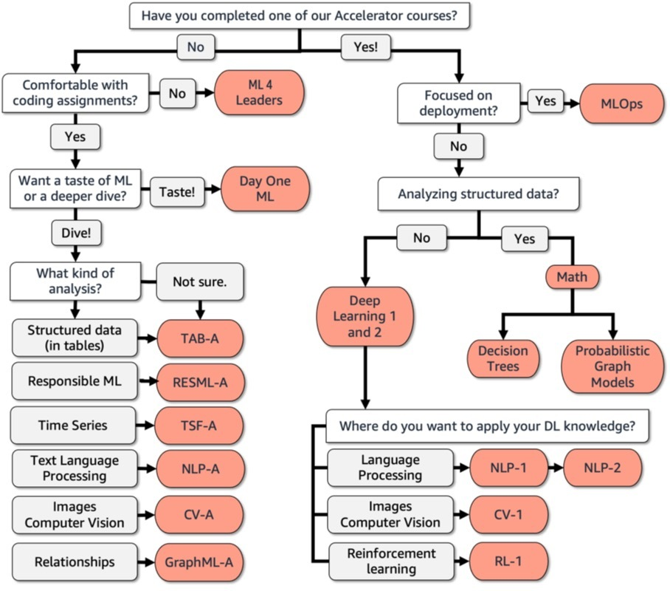
You are here

Slide 104
Instructor Alias:
Start Date:

Slide 105
Use Case 2: Sentiment Analysis
We will now use a subset of questions from the MLDQ handbook to discuss ML problems that teams at Amazon have faced.
Amazon customers’ feedback data (customer service contacts, product reviews, return comments) encapsulates valuable information about users. Sentiment analysis provides a unique window into customers’ experience. Understanding text sentiment allows Amazon to improve their products to better meet customers’ needs.
We want to build ML predictive models that can generate sentiment analysis scores for Heartbeat (the Voice of the Customer) text data.

Slide 106

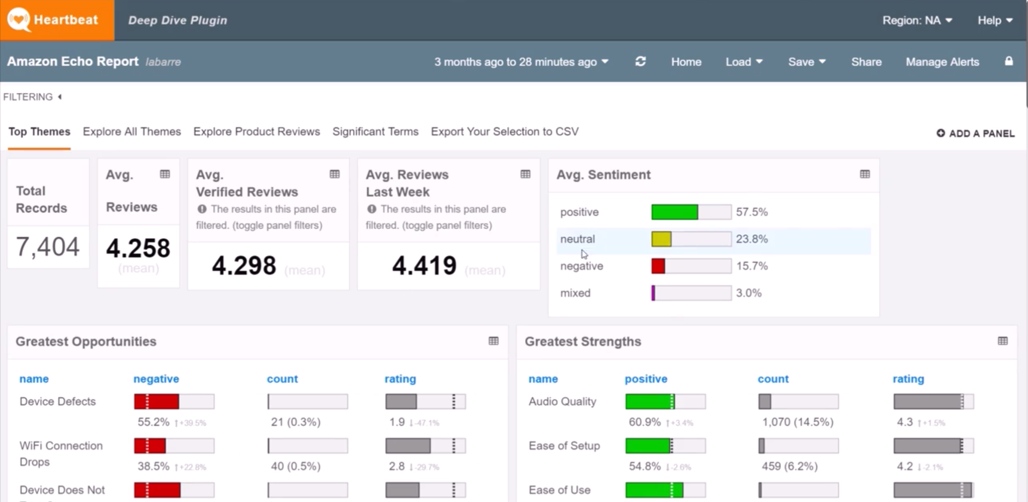
Heartbeat
https://w.amazon.com/index.php/CSTech/Heartbeat
Notes:
Heartbeat uses a sentiment scorer to classify customer feedback as positive/netural/negative/mixed.
More info: https://drive.corp.amazon.com/documents/szarvasg@/tech_reports/sentiment.pdf
More info: https://w.amazon.com/bin/view/CSTech/Heartbeat/NLP/AspectBasedSentiment/
Labels are quite stable, all d2cs and beauty sets were triple annotated by pre-selected MTurk workers.
See here for Sigmund – a Sentiment Analysis Scoring Improvement in Heartbeat: https://w.amazon.com/bin/view/WWDE_ML/home/sentiment_scoring_in_heartbeat/

Slide 107
MLDQs for discussion
What makes this problem suitable for Machine Learning?
Manual extraction of text sentiment at scale is intractable. Simple rules based on presence of positive or negative words in a sentence will not solve many real cases (nuanced language, mixed sentiments, etc)

Slide 108
MLDQs for discussion
What makes this problem suitable for Machine Learning?
Manual extraction of text sentiment at scale is intractable. Simple rules based on presence of positive or negative words in a sentence will not solve many real cases (nuanced language, mixed sentiments, etc)
What business goal can be achieved by building a ML solution to tackle this problem?
Customer understanding: Knowing what users think and how they feel about products adds context to the raw text and enables prioritization. It also helps surface problems and customer dissatisfaction early on.

Slide 109
MLDQs for discussion
What makes this problem suitable for Machine Learning?
Manual extraction of text sentiment at scale is intractable. Simple rules based on presence of positive or negative words in a sentence will not solve many real cases (nuanced language, mixed sentiments, etc)
What business goal can be achieved by building a ML solution to tackle this problem?
Customer understanding: Knowing what users think and how they feel about products adds context to the raw text and enables prioritization. It also helps surface problems and customer dissatisfaction early on.
What kind of ML model (regression/classification/clustering?) can solve this problem?
Either binary classification (positive/negative) or multi-class classification (scale of sentiments from angry to neutral to happy) can be used. Heartbeat uses 4 classes: positive/negative/neutral/mixed.

Slide 110
MLDQs for discussion
What data might be necessary to address this problem? Is the data already available & relevant?
To solve this, we need a dataset with text (customer contacts, product reviews, return messages) with correspondent sentiment labels. Text data can be extracted from Heartbeat. Human annotation of it is required, which might be costly.

Slide 111
MLDQs for discussion
What data might be necessary to address this problem? Is the data already available & relevant?
To solve this, we need a dataset with text (customer contacts, product reviews, return messages) with correspondent sentiment labels. Text data can be extracted from Heartbeat. Human annotation of it is required, which might be costly.
How accurate/good does the model need to be?
Typically classification accuracy will be used. Both micro- and macro-averages over the multiple sentiment classes can be computed to identify the performance of the classifier towards the different labels.

Slide 112
Use Case 3: ASIN Translation
We will now use a subset of questions from the MLDQ handbook to discuss ML problems that teams at Amazon have faced.
As a global company, Amazon works with sellers and customers in multiple marketplaces. Sellers want to sell internationally without language barriers. Customers want to buy products in their chosen language. An automated solution is required to localize the catalog’s enormous volume.
We want to build high-quality, scalable, cost-efficient ML models for product data translation (Machine Translation) across all Amazon marketplaces.

Slide 113
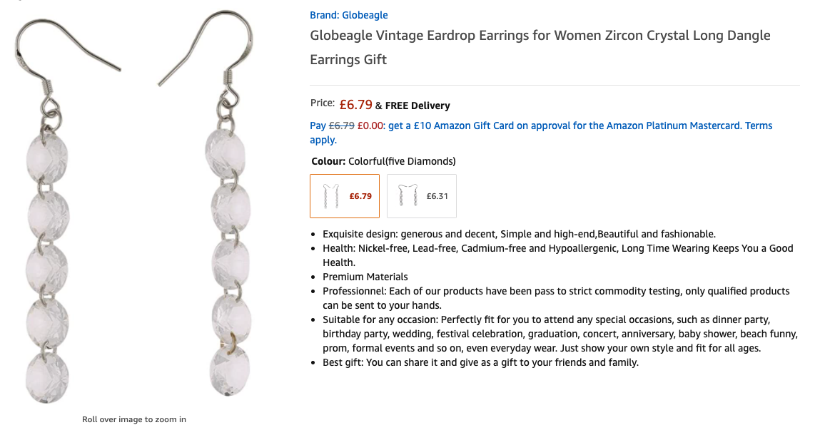

Saar (Amazon’s internal translation service)
https://w.amazon.com/bin/view/Saar/
Notes:
Saar (pronounced as "Zaar") is Amazon’s internal Machine Translation (MT) asynchronous service that provides high quality low cost translations of product data (titles, bullet points, descriptions, etc.).
The Saar team is based in Berlin. Saar MT helps Amazon customers to buy products in their chosen languages and enables sellers and retail teams to sell internationally without language barriers.
The vision is to provide high-quality, scalable, cost-efficient product data translation across all Amazon marketplaces.
They also own a set of other tier-1 and tier-2 MT services hosting domain adopted MT models for various use-cases.
Saar is currently translating millions of ASINs per day. They have MT engines to provide high quality translations of ASIN titles, bullet points, descriptions, search keywords.

Slide 114
MLDQs for discussion
What makes this problem suitable for Machine Learning?
Human translation of text is costly and time consuming. Rule-based approaches will fail on complex text such as product bullet points and descriptions. Machine Translation is the most suitable approach for this.

Slide 115
MLDQs for discussion
What makes this problem suitable for Machine Learning?
Human translation of text is costly and time consuming. Rule-based approaches will fail on complex text such as product bullet points and descriptions. Machine Translation is the most suitable approach for this.
What business goal can be achieved by building a ML solution to tackle this problem?
Customer reach: MT at scale can localize millions of products per day, dramatically increasing the number of customers that are exposed to them. It also enables sellers to grown their businesses, benefitting Amazon

Slide 116
MLDQs for discussion
What makes this problem suitable for Machine Learning?
Human translation of text is costly and time consuming. Rule-based approaches will fail on complex text such as product bullet points and descriptions. Machine Translation is the most suitable approach for this.
What business goal can be achieved by building a ML solution to tackle this problem?
Customer reach: MT at scale can localize millions of products per day, dramatically increasing the number of customers that are exposed to them. It also enables sellers to grown their businesses, benefitting Amazon
What kind of ML model (regression/classification/clustering?) can solve this problem?
Machine Translation is a language generation problem where input and output are in different languages.

Slide 117
MLDQs for discussion
What data might be necessary to address this problem? Is the data already available & relevant?
To solve this, we need a large corpus of parallel translations of product data. This can be acquired via in-house translators or specialized agencies. To ensure that data is current and relevant, more amounts of parallel translations might be required at times for model re-trainings.

Slide 118
MLDQs for discussion
What data might be necessary to address this problem? Is the data already available & relevant?
To solve this, we need a large corpus of parallel translations of product data. This can be acquired via in-house translators or specialized agencies. To ensure that data is current and relevant, more amounts of parallel translations might be required at times for model re-trainings.
How accurate/good does the model need to be?
MT models are evaluated via automated metrics such as BLEU that measure the correspondence between the model’s output and a reference translation. Additionally, human evaluation metrics might be required to assess various aspects of translation quality.

Slide 119
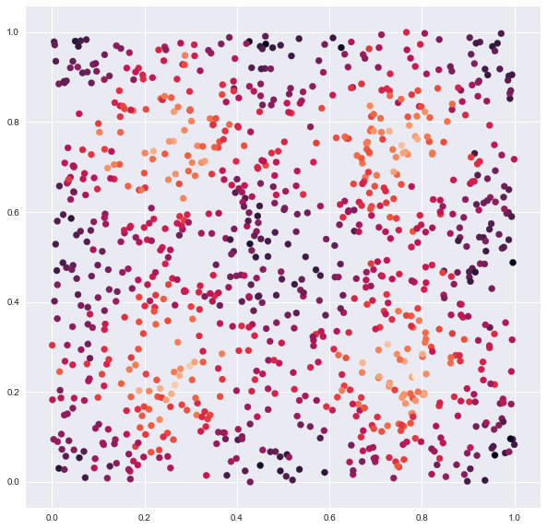

Ensembling: The Data
Price
Normalized Reviews
Normalized Ratings

Slide 120
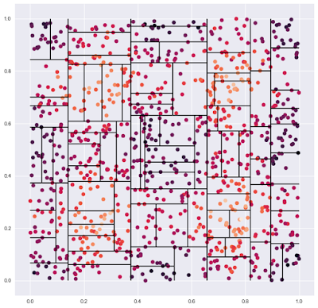
Ensembling: A Decision Tree
Price
Normalized Reviews
Normalized Ratings

Slide 121
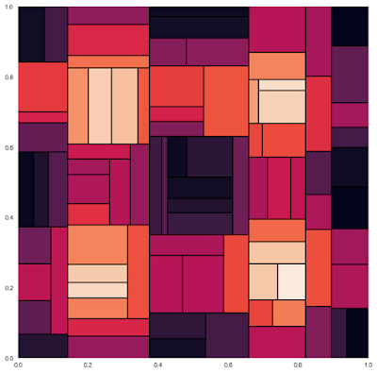
Ensembling: A Decision Tree
Price
Normalized Reviews
Normalized Ratings

Slide 122
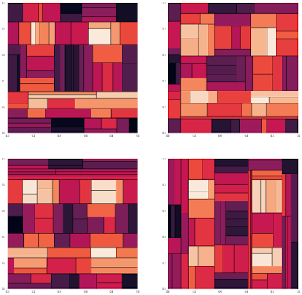
Ensembling: Many Decision Trees
Price
Each tree gives slightly different predictions.

Slide 123
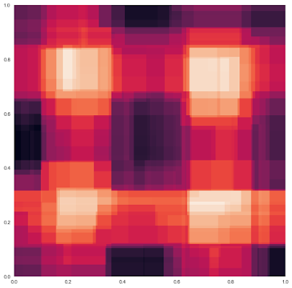
Ensembling: Random Forest
Price
Many are better than one: by combining through average we get better predictions.
Normalized Reviews
Normalized Ratings

